Slide 1
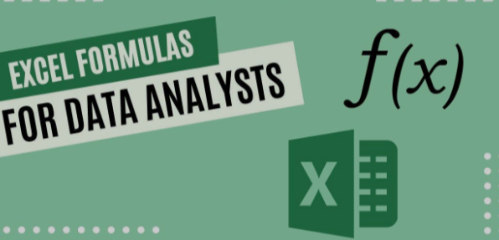

Slide 2
What is Excel
Excel is a powerful spreadsheet program developed by Microsoft, part of the
Microsoft Office suite. It is widely used for data organization, analysis, and
visualization. Excel is commonly used in business, finance, research, and
education for tasks ranging from budgeting and forecasting to project
management and data analysis.

Slide 3
Why Excel basic formulas
Using basic formulas in Excel offers several advantages:
Efficiency: Formulas automate calculations, saving you time compared to manual computations.
Accuracy: Excel reduces the risk of human error in calculations, ensuring more reliable results.
Data Analysis: Formulas allow you to analyze data quickly, helping you make informed decisions based on trends and insights.
Organization: With formulas, you can keep your data organized and dynamic, allowing for real-time updates as data changes.
Simplified Reporting: Formulas enable you to create summaries, averages, and totals that can easily be included in reports.
Versatility: They can be applied to various types of data, from financial figures to inventory lists, making Excel a flexible tool for many tasks.
Enhanced Presentation: Using formulas helps present data clearly, with calculations that automatically update, which is especially useful in shared documents.

Slide 4
Sum function
The SUM function in Excel is used to add together a range of numbers or individual values. It's one of the most commonly used functions for quick calculations. Here’s how it works:
Syntax:
=SUM(number1, [number2], ...)
number1: The first number or range of cells you want to add.
number2: (Optional) Additional numbers or ranges you want to include in the sum.

Slide 5
Average function
The AVERAGE function in Excel is used to calculate the mean (average) of a group of numbers. It's a straightforward way to find out the central value of a dataset.
Syntax:
=AVERAGE(number1, [number2], ...)
number1: The first number or range of cells you want to include in the average.
number2:(Optional) Additional numbers or ranges you want to include.

Slide 6
Min function
he MIN function in Excel is used to find the smallest value in a set of numbers or a range of cells. It’s useful for identifying the minimum value in your dataset.
Syntax:
=MIN(number1, [number2], ...)
Number1: The first number or range of cells you want to evaluate.
Number2: (Optional) Additional numbers or ranges you want to include.

Slide 7
Max function
The MAX function in Excel is used to find the largest value in a set of numbers or a range of cells. It’s helpful for identifying the maximum value in your dataset.
Syntax:
=MAX(number1, [number2], ...)
Number1: The first number or range of cells you want to evaluate.
Number2: (Optional) Additional numbers or ranges you want to include.

Slide 8
COUNT function
The COUNT function in Excel is used to count the number of cells that contain numeric values within a specified range. It's useful for determining how many entries in a dataset are numerical.
Syntax:
=COUNT(value1, [value2], ...)
Value1: The first argument or range of cells you want to count.
Value2: (Optional) Additional numbers or ranges you want to include.

Slide 9
COUNT BLANK
The COUNTBLANK function in Excel is used to count the number of empty (blank) cells in a specified range. This can be useful for analyzing data sets and identifying gaps in your data.
Syntax:
=COUNTBLANK(range)
range: The range of cells you want to count blank cells in.

Slide 10
conclusion
Overall, mastering basic formulas in Excel can significantly enhance your
productivity and effectiveness in handling data. These formulas can be a
great starting point for performing basic calculations and data manipulation
in Excel!
anjushaji6@gmail.com

